Slide 1

Fast-Food Industry Analysis: U.S. Sales & Growth Trends (2023)
By: Eliza Alanis & Ricardo Sanchez

Slide 2
Dataset Used
https://www.kaggle.com/datasets/itzusama/top-50-fast-food-chains-ranked-2024
Added a calculated field for "Total Units Change" in the double bar chart to display the difference in restaurant locations between 2022 and 2023.

Slide 3
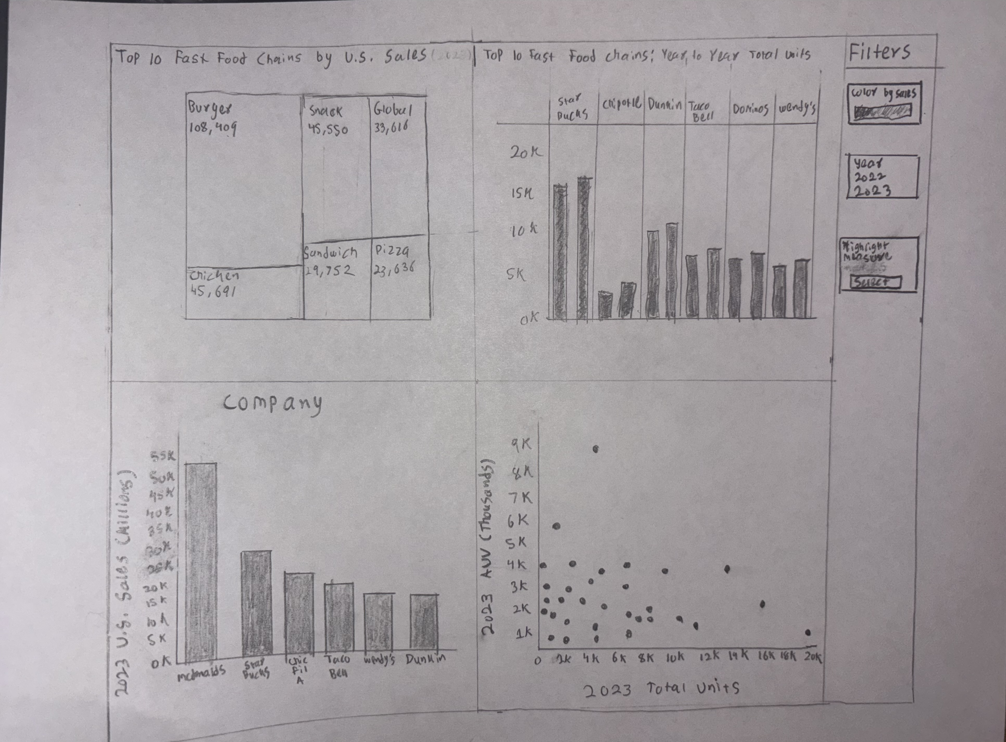
Sketch of Dashboard

Slide 4
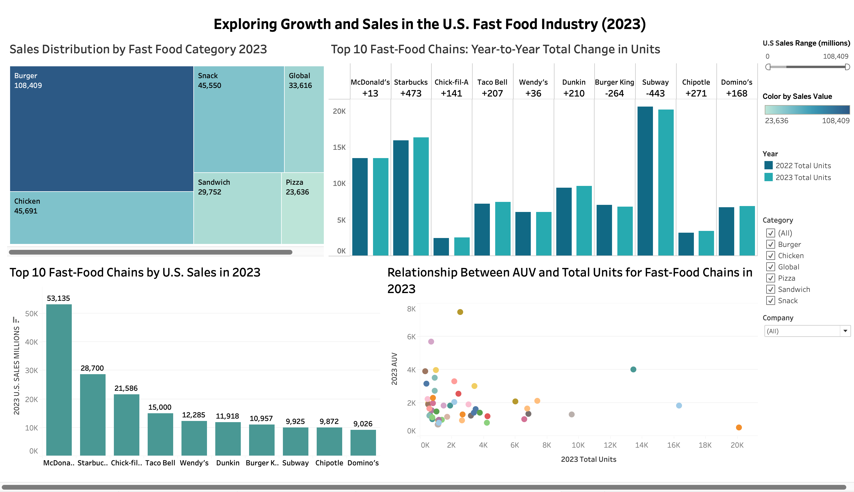
Dashboard

Slide 5
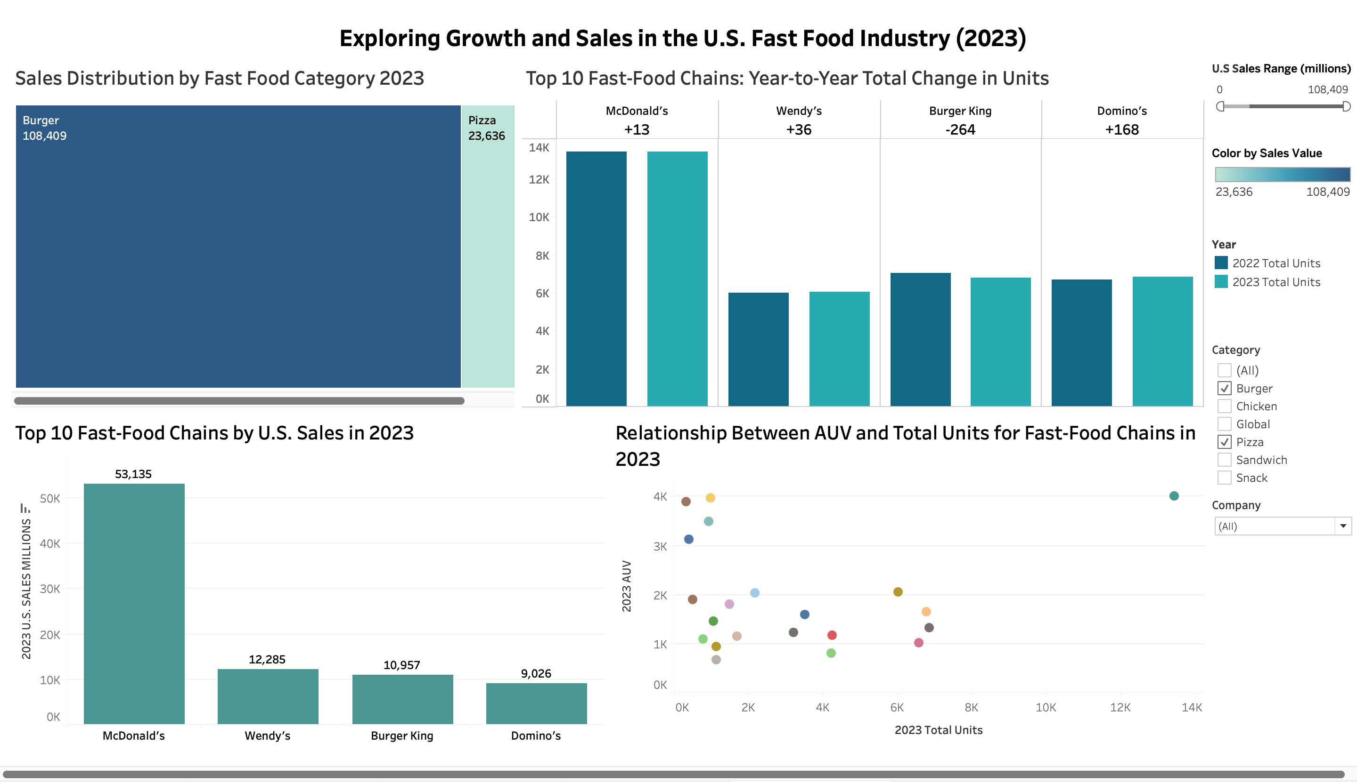
Filtering Burgers and Pizza related fast-food chains in the U.S:
BEFORE
AFTER

Slide 6
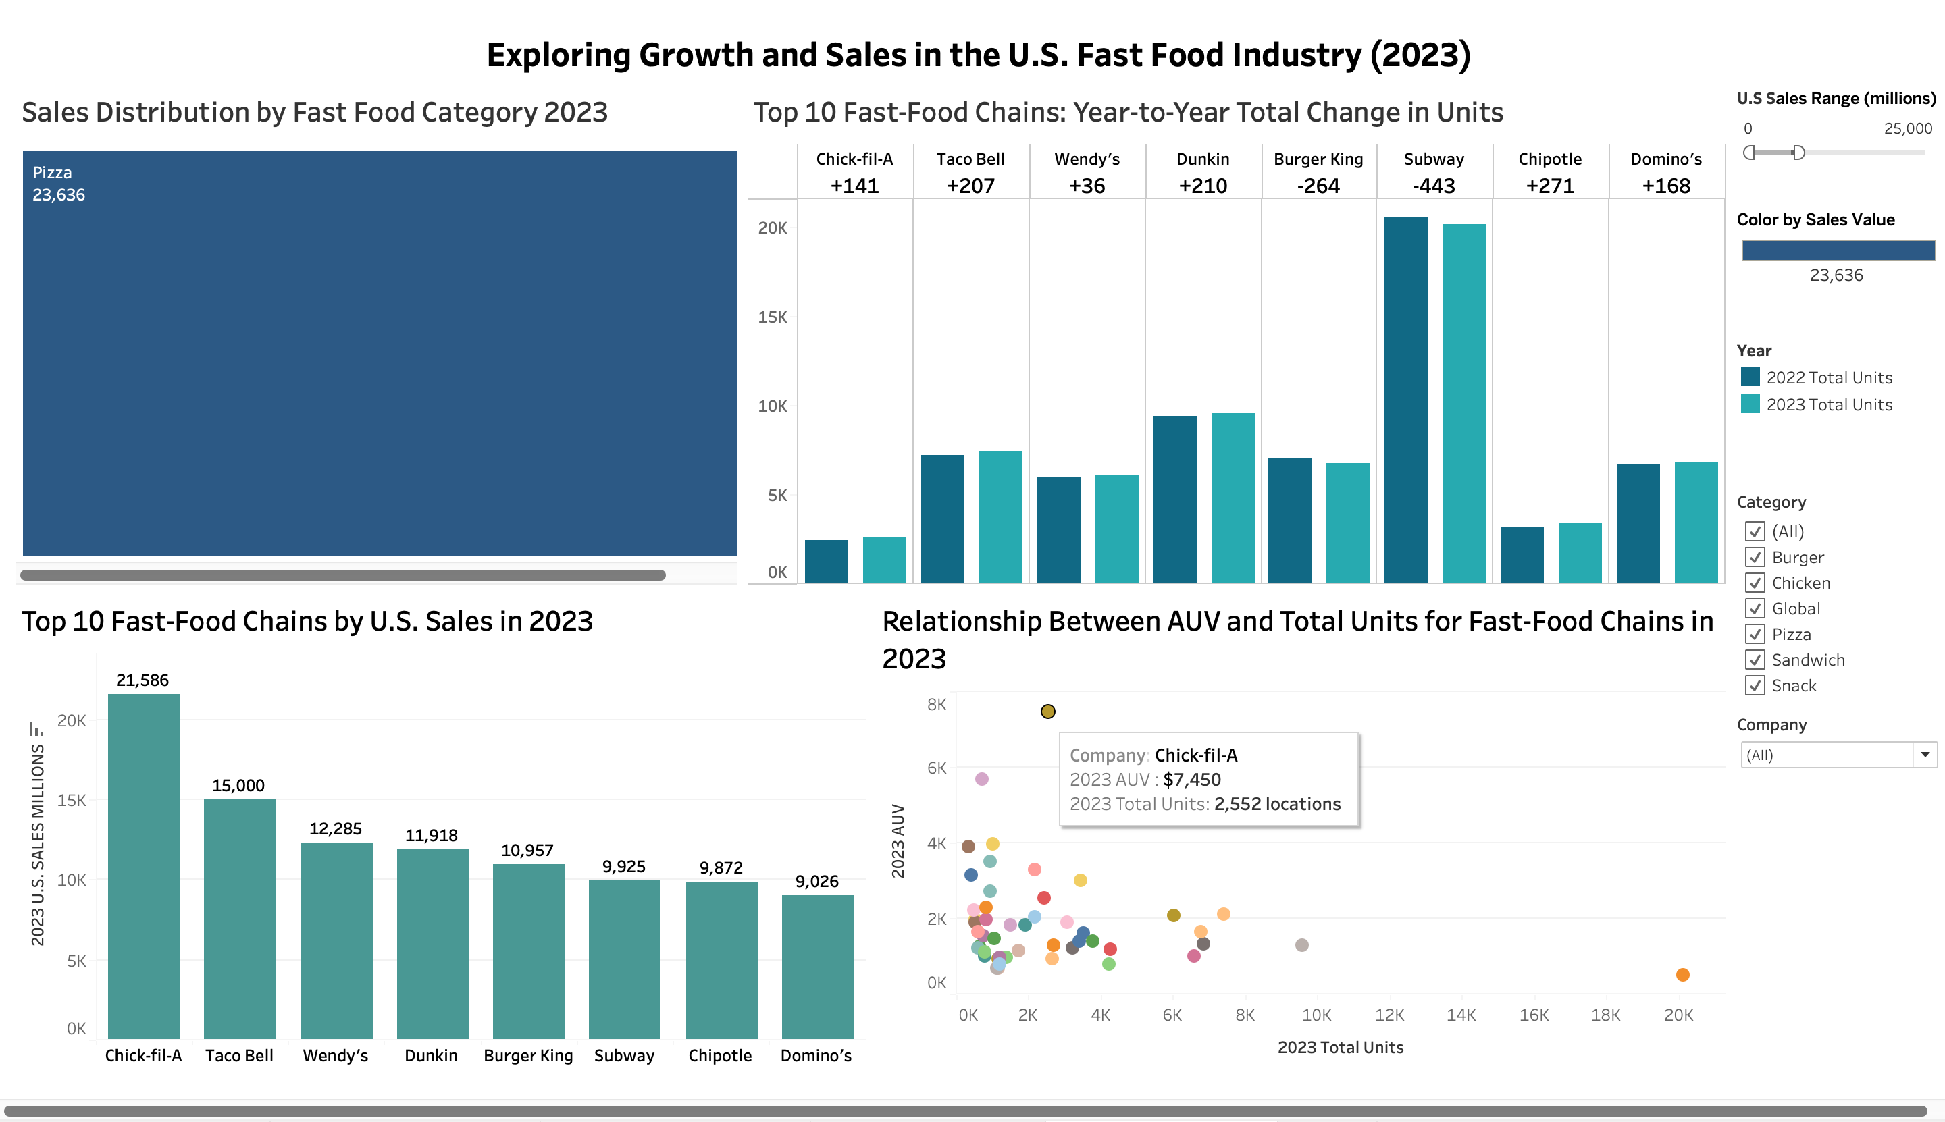
Filtering fast-food chains that made $25B or less in 2023 total U.S sales:
BEFORE
AFTER

Slide 7

Fast Food Industry Trends: Insights
Key Insights:
Category Performance Differences – Certain food categories (e.g., burgers vs. chicken vs. pizza) show stronger sales, highlighting consumer preferences.
Growth Trends in Locations Vary – Some chains expanded rapidly in 2023, while others saw a decline or remained unchanged in total U.S locations. This suggests that market strategies are changing.

Slide 8
Fast Food Industry Trends: Insights
Key Insights:
Market Leaders Dominate: A select few large chains generate significantly higher sales, showcasing their market power, efficiency, and brand recognition within the United States in 2023.
AUV vs. Total Units Tradeoff: Some brands generate high sales per unit but have fewer locations while others prioritize lower AUV’s with more locations. Showing the differences in approach to grow from these companies

Slide 9

Fast Food Industry Trends: Recommendations
Recommended Actions:
Competitive Differentiation – Lower-performing brands should study what top chains do differently (pricing, promotions, customer experience) and adapt strategies accordingly.
Strategic Site Selection: Rather than focusing on large expansions that could result in poor performance, growth should be directed toward areas with proven demand.
Data-Driven Decisions: Use location-driven data metrics to decide whether to optimize operations, shutdown underperforming locations, or expand with more locations.

